Slide 1
Momentum
Chapter 7-Cutnell & Johnson

Slide 2
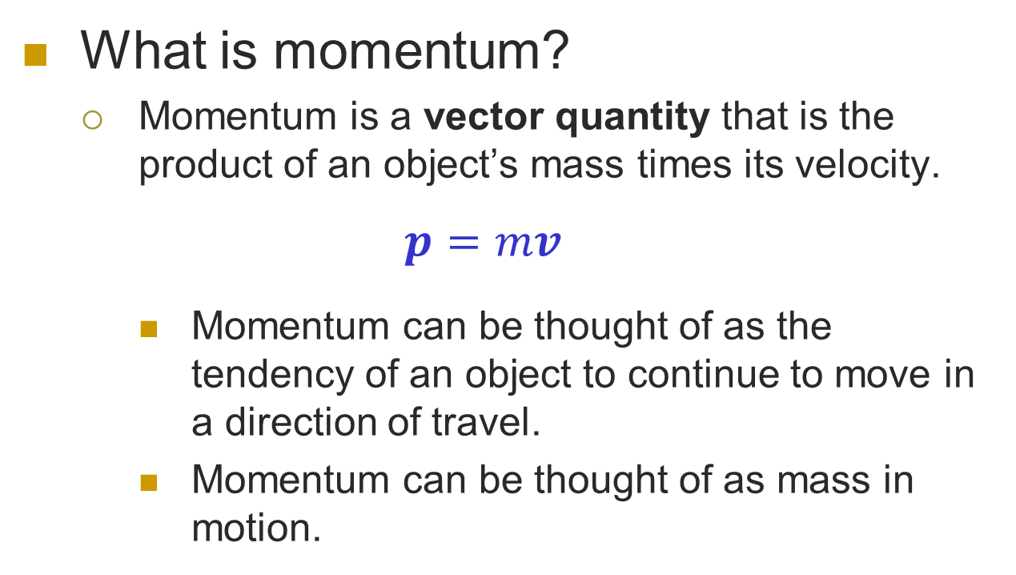
Momentum (p)
What is momentum?
  Momentum is a vector quantity that is the product of an object’s mass times its velocity.
  $$p=mv$$
    Momentum can be thought of as the tendency of an object to continue to move in a direction of travel.
    Momentum can be thought of as mass in motion.

Slide 3
Effects of mass and velocity on Momentum
A bowler is experimenting with a couple of bowling balls, one with a mass of 3.5 kg and the other with a mass of 7.0 kg.
  What will be the effect on momentum if the bowler changes from the 3.5 kg bowling ball to the 7.0 kg bowling ball if the velocity remains constant?
  What will be the effect on momentum of the 7.0 kg bowling ball be if the velocity is changed from 2 m/s to 4 m/s?
Changes in mass and velocity are directly proportional to changes in momentum; e.g. if you double one, you will double the other.

Slide 4
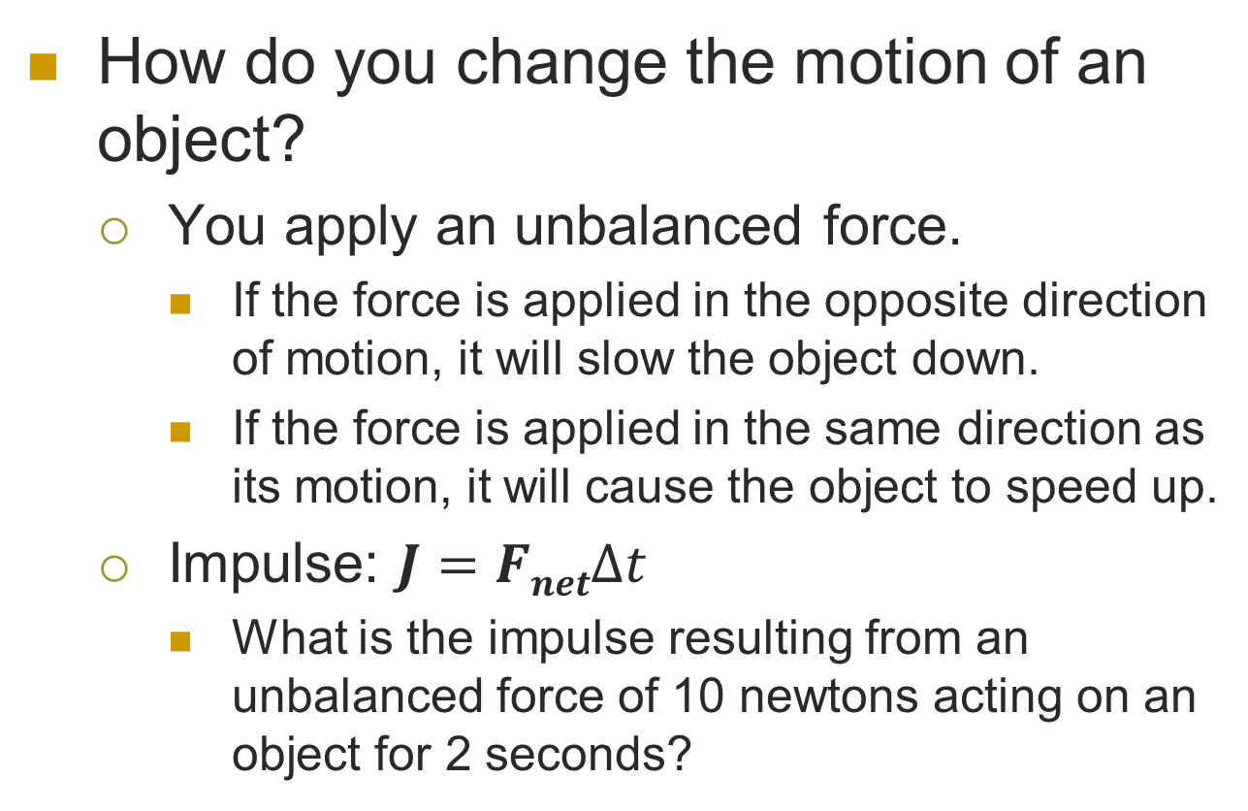
Impulse
How do you change the motion of an object?
  You apply an unbalanced force.
    If the force is applied in the opposite direction of motion, it will slow the object down.
    If the force is applied in the same direction as its motion, it will cause the object to speed up.
  Impulse: $J=FnetΔt$
    What is the impulse resulting from an unbalanced force of 10 newtons acting on an object for 2 seconds?

Slide 5
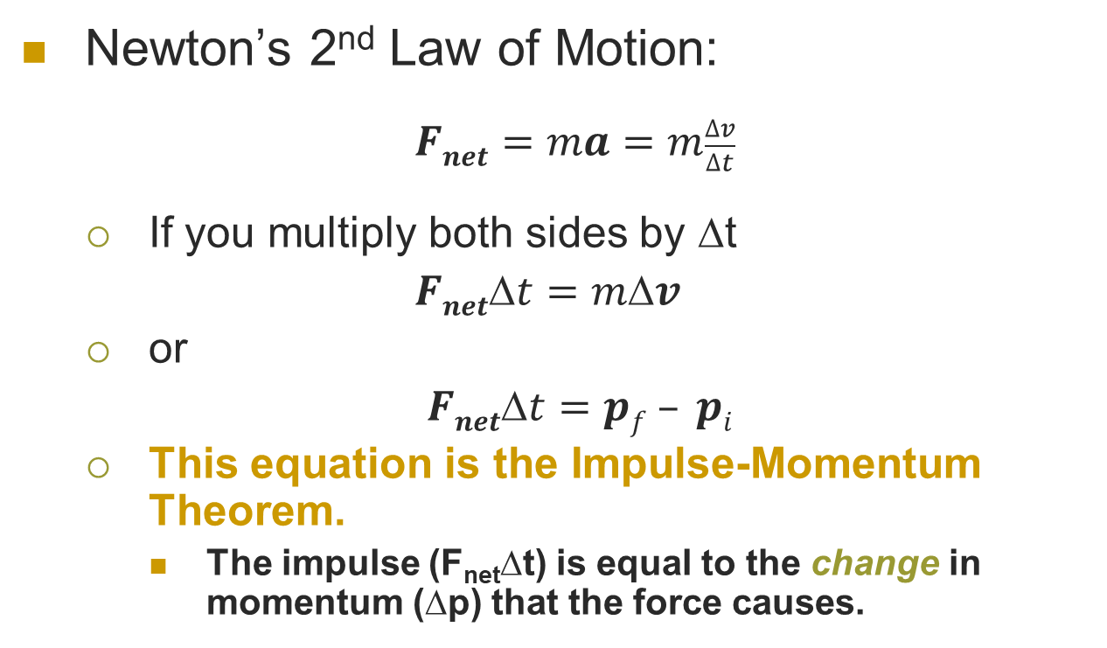
Impulse and Newton’s 2nd Law
Newton’s 2nd Law of Motion:
  $Fnet=ma=m\frac{∆v}{∆t}$
  If you multiply both sides by Δt
  $Fnett=mv$
  or
  $Fnett=pf – pi$
  This equation is the Impulse-Momentum Theorem.
    The impulse (F_{net}Δt) is equal to the change in momentum (Δp) that the force causes.

Slide 6
Units for Impulse and Momentum
What are the units for momentum?
  1 Unit of Momentum = 1 kg•m/s
What are the units for Impulse?
  1 Unit of Impulse = 1 N•s
Since impulse equals momentum:
  1 N•s = 1 kg•m/s

Slide 7

Example 1:
A batter makes contact with a 0.145 kg baseball traveling at 40 m/s with an average force of 5,000 N for 0.003 seconds. What is the momentum and velocity of the ball after it leaves the bat.

Slide 8
Diagram the Problem
If the initial velocity of the ball is assumed to be in the positive direction, then the ball will be moving in the negative direction after making contact with the bat.
Before
v_{i} = 40 m/s
F = -5,000N
After
v_{f} = ?

Slide 9

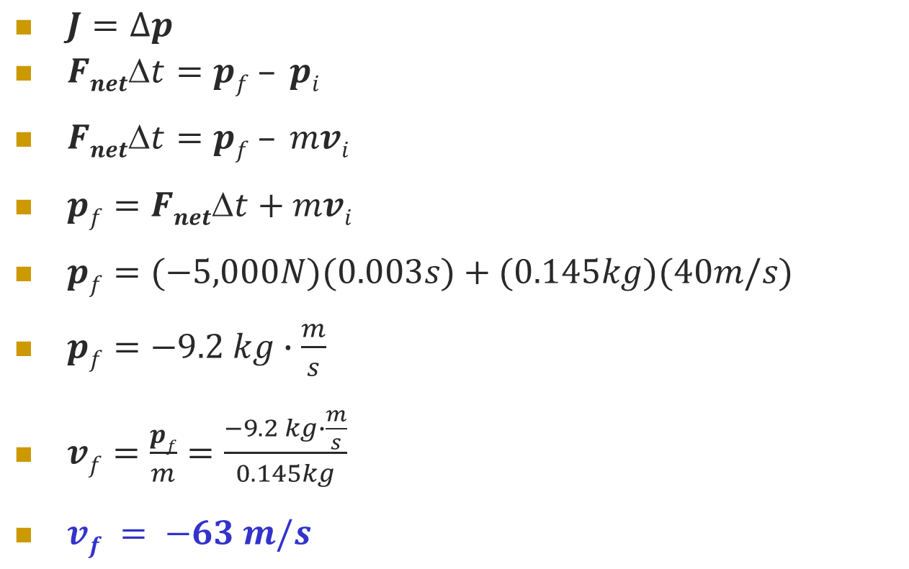
Solve the Problem
$J=∆p$
$Fnett=pf – pi$
$Fnett=pf – mvi$
$pf=Fnett+mvi$
$pf=(−5,000N)(0.003s)+(0.145kg)(40m/s)$
$pf=−9.2 kg∙\frac{m}{s}$
$vf=\frac{pf}{m}=\frac{−9.2 kg∙\frac{m}{s}}{0.145kg}$
$vf = −63 m/s$
Given Parameters
$$m=0.145 kg$$
$$v_{i}=40 \frac{m}{s}$$
$$F_{net}=−5,000N$$
$$t=0.003 s$$

Slide 10


Using Impulse and Momentum for Safety
A large impulse will result in a large change in momentum.
  A large impulse can result from a large force over a very short period of time.
  A large impulse can result from a small force over a very long period of time.
For automotive safety, seatbelts, air bags and crumple zones reduce the forces on the occupants by extending the time over which deceleration occurs.
$J=$ $F_{net}$ $∆t$
$J=$ $F_{net}$ $∆t$

Slide 11
Example 2:
A 2,200 kg SUV is traveling at 94 km/hr (~55 mph) stops in 21 seconds when using the brakes gently or 5.5 seconds when in a panic. However, the vehicle will come to a halt in 0.22 seconds if it hits a concrete wall. What is the average force exerted in each of these stops?

Slide 12

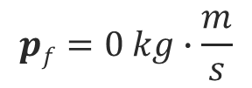

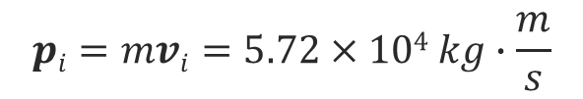
Diagram the Problem
$$vi=94 km/hr=26 m/s$$
$$vf=0 m/s$$
$$pi=mvi=5.72×104 kg∙\frac{m}{s}$$
$$pf=0 kg∙\frac{m}{s}$$
Impulse (FΔt)

Slide 13
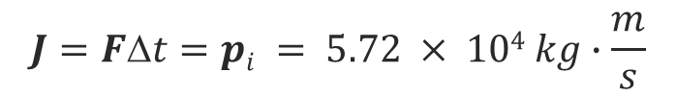
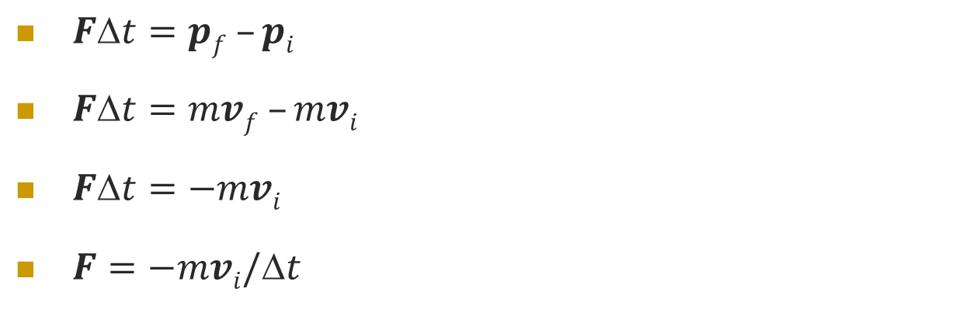
Solve the Problem
$Ft=pf –pi$
$Ft=mvf –mvi$
$Ft=−mvi$
$F=−mvi/t$
0
$$J=FΔt=pi = 5.72 × 104 kg∙\frac{m}{s}$$
t | 21 s | 5.5 s | 0.22 s
F | -2,700 N (607 lbs) | -10,000 N (2,250 lbs) | -260,000 N (58,400 lbs)

Slide 14
Conservation of Momentum in Collisions
Newton’s 3rd Law of motion says that for every action there is an equal and opposite reaction.
  The force on one object is equal and opposite to the force on the other object
F_{8 on cue}
F_{cue on 8}

Slide 15
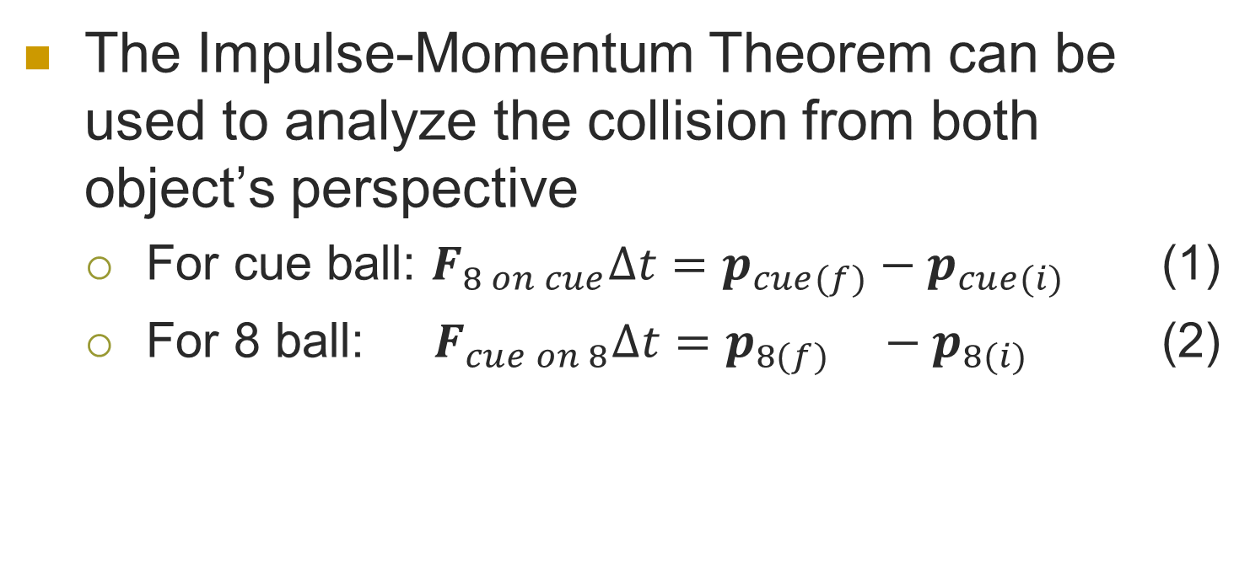
Collisions and the Impulse Momentum Theorem
The Impulse-Momentum Theorem can be used to analyze the collision from both object’s perspective
  For cue ball: $F_{8 on cue}Δt=p_{cue(f)}−p_{cue(i)}$ (1)
  For 8 ball: $F_{cue on 8}Δt=p_{8(f)} −p_{8(i)}$ (2)
F_{8 on cue}
F_{cue on 8}

Slide 16
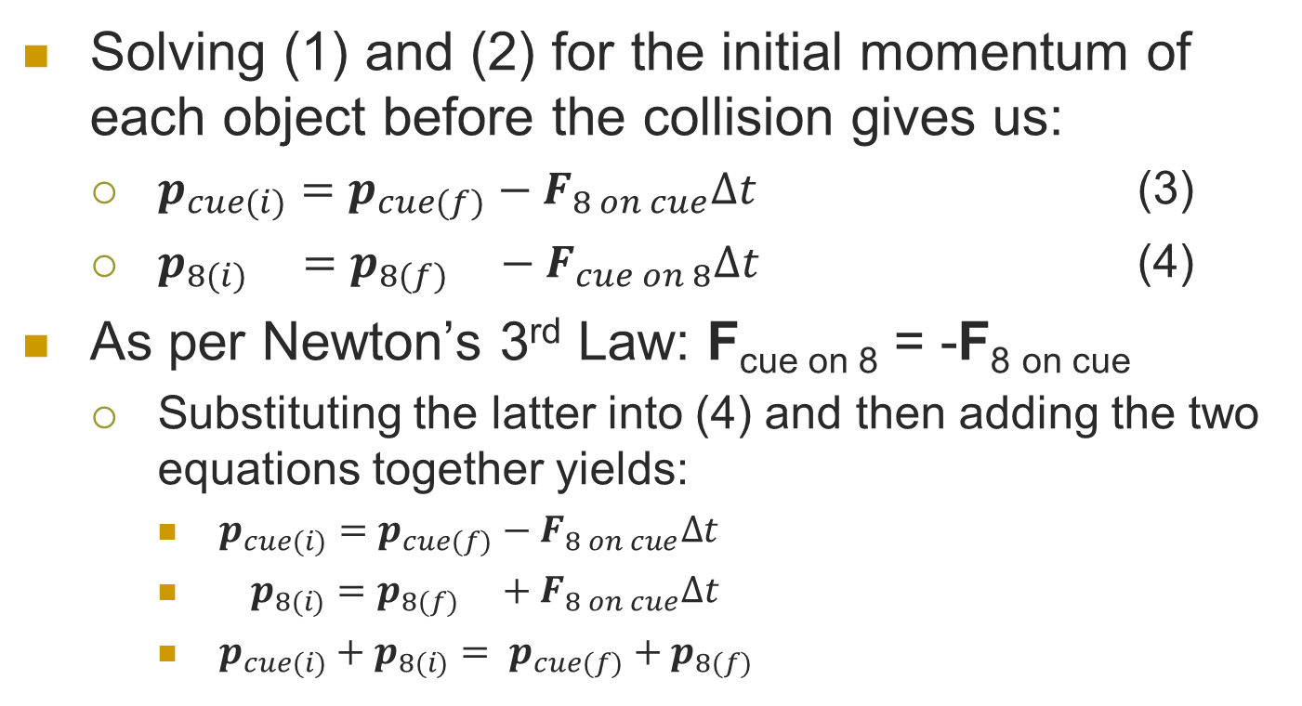
Conservation of Momentum in Collisions
Solving (1) and (2) for the initial momentum of each object before the collision gives us:
  $p_{cue(i)}=p_{cue(f)}−F_{8 on cue}Δt$ (3)
  $p_{8(i)} =p_{8(f)} −F_{cue on 8}Δt$ (4)
As per Newton’s 3rd Law: F_{cue on 8} = -F_{8 on cue}
  Substituting the latter into (4) and then adding the two equations together yields:
    $p_{cue(i)}=p_{cue(f)}−F_{8 on cue}Δt$
    $p_{8(i)}=p_{8(f)} +F_{8 on cue}Δt$
    $p_{cue(i)}+p_{8(i)}= p_{cue(f)}+p_{8(f)}$

Slide 17
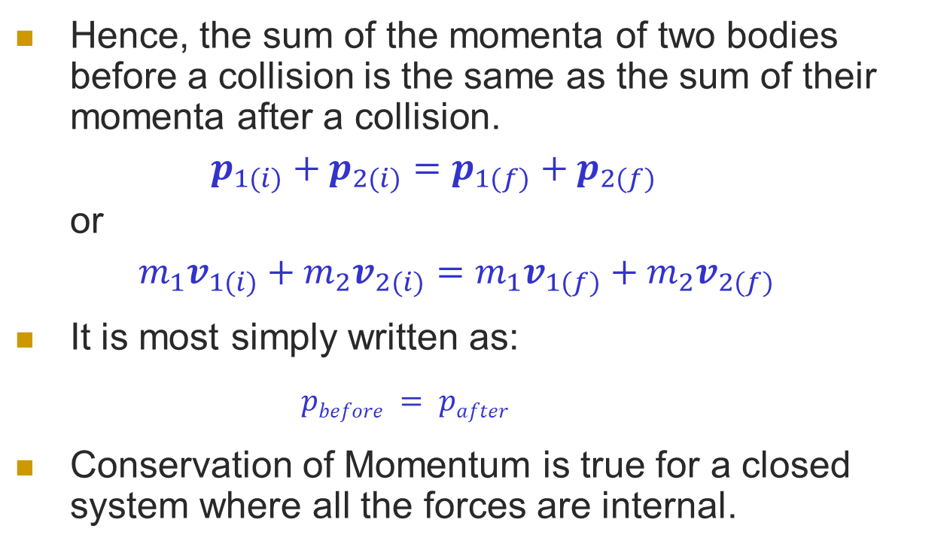
Law of Conservation of Momentum
Hence, the sum of the momenta of two bodies before a collision is the same as the sum of their momenta after a collision.
$p_{1(i)}+p_{2(i)}=p_{1(f)}+p_{2(f)}$
or
$m_{1}v_{1(i)}+m_{2}v_{2(i)}=m_{1}v_{1(f)}+m_{2}v_{2(f)}$
It is most simply written as:
  $pbefore = pafter$
Conservation of Momentum is true for a closed system where all the forces are internal.

Slide 18
Example 3
Cart A approaches cart B, which is initially at rest, with an initial velocity of 30 m/s. After the collision, cart A stops and cart B continues on with what velocity? Cart A has a mass of 50 kg while cart B has a mass of 100kg.
A
B

Slide 19




Diagram the Problem
A
B
Before Collision:
$$pAi=mvAi$$
$$pBi=mvBi=0$$
After Collision:
$$pAf=mvAf=0$$
$$pBf=mvBf$$

Slide 20
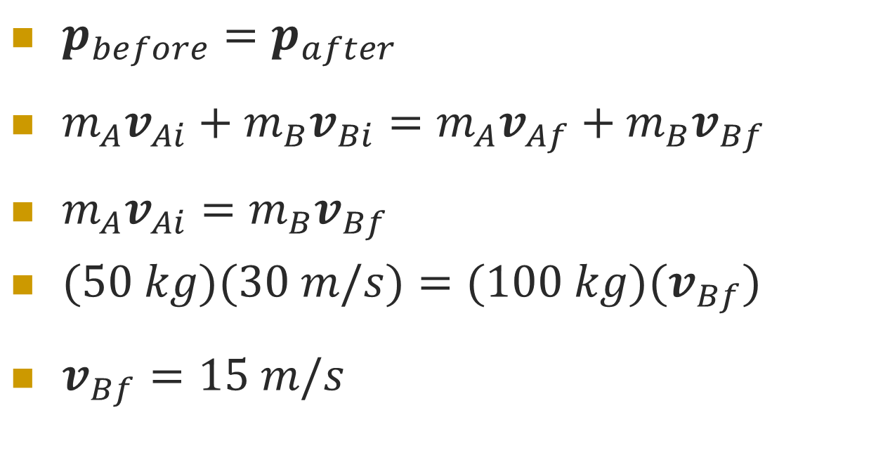
Solve the Problem
$p_{before}=p_{after}$
$m_{A}v_{Ai}+m_{B}v_{Bi}=m_{A}v_{Af}+m_{B}v_{Bf}$
$m_{A}v_{Ai}=m_{B}v_{Bf}$
$(50 kg)(30 m/s)=(100 kg)(v_{Bf})$
$v_{Bf}=15 m/s$
0
0

Slide 21
Example 4
Cart A approaches cart B, which is initially at rest, with an initial velocity of 30 m/s. After the collision, cart A and cart B continue on together with what velocity? Cart A has a mass of 50 kg while cart B has a mass of 100kg.
A
B

Slide 22




Diagram the Problem
A
B
Before Collision:
$$p_{Ai}=mv_{Ai}$$
$$p_{Bi}=mv_{Bi}=0$$
After Collision:
$$p_{Af}=mv_{Af}$$
$$p_{Bf}=mv_{Bf}$$
Note: Since the carts stick together after the collision, $vAf=vBf=vf$.

Slide 23

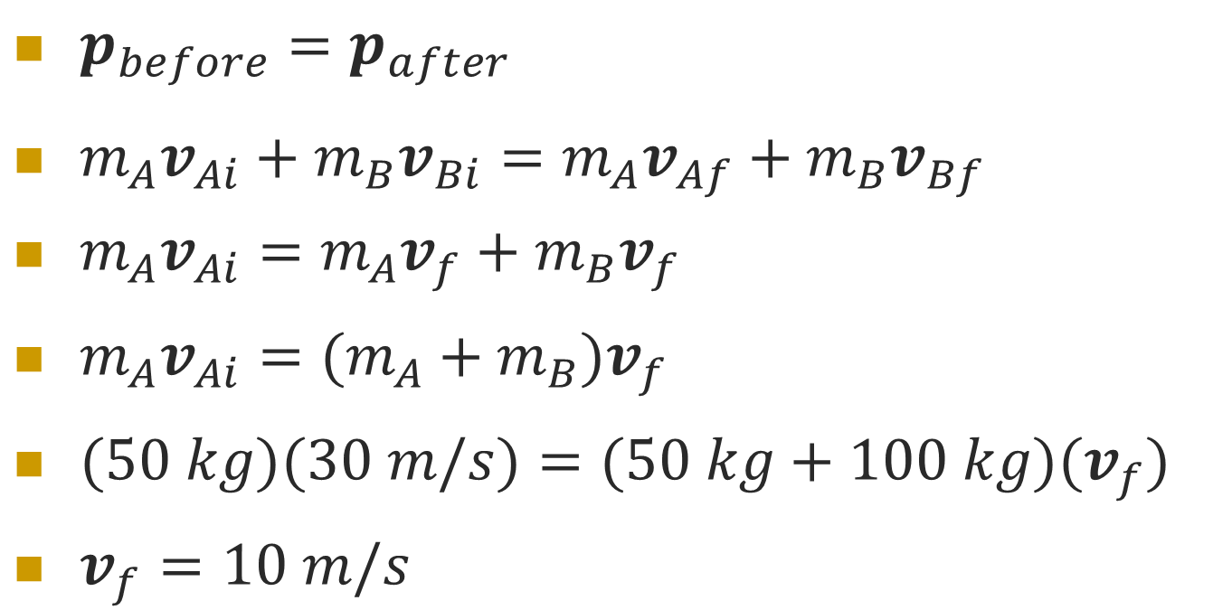
Solve the Problem
$$vAf=vBf=vf$$
$p_{before}=p_{after}$
$m_{A}v_{Ai}+m_{B}v_{Bi}=m_{A}v_{Af}+m_{B}v_{Bf}$
$m_{A}v_{Ai}=m_{A}v_{f}+m_{B}v_{f}$
$m_{A}v_{Ai}=(m_{A}+m_{B})v_{f}$
$(50 kg)(30 m/s)=(50 kg+100 kg)(v_{f})$
$v_{f}=10 m/s$
0

Slide 24
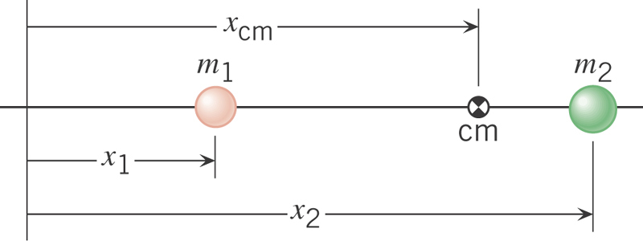
Center of Mass
A measure of the average location for the total mass of a system of objects.

Slide 25
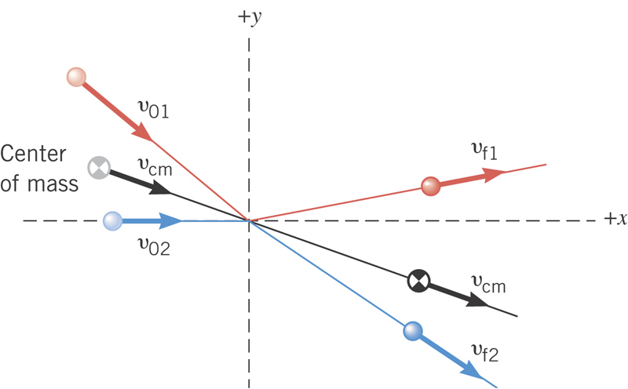
Center of Mass and Momentum
While the velocity of various particles in a system may change in the event of a collision, the velocity of the center of mass will remain constant before and after the collision.

Slide 26
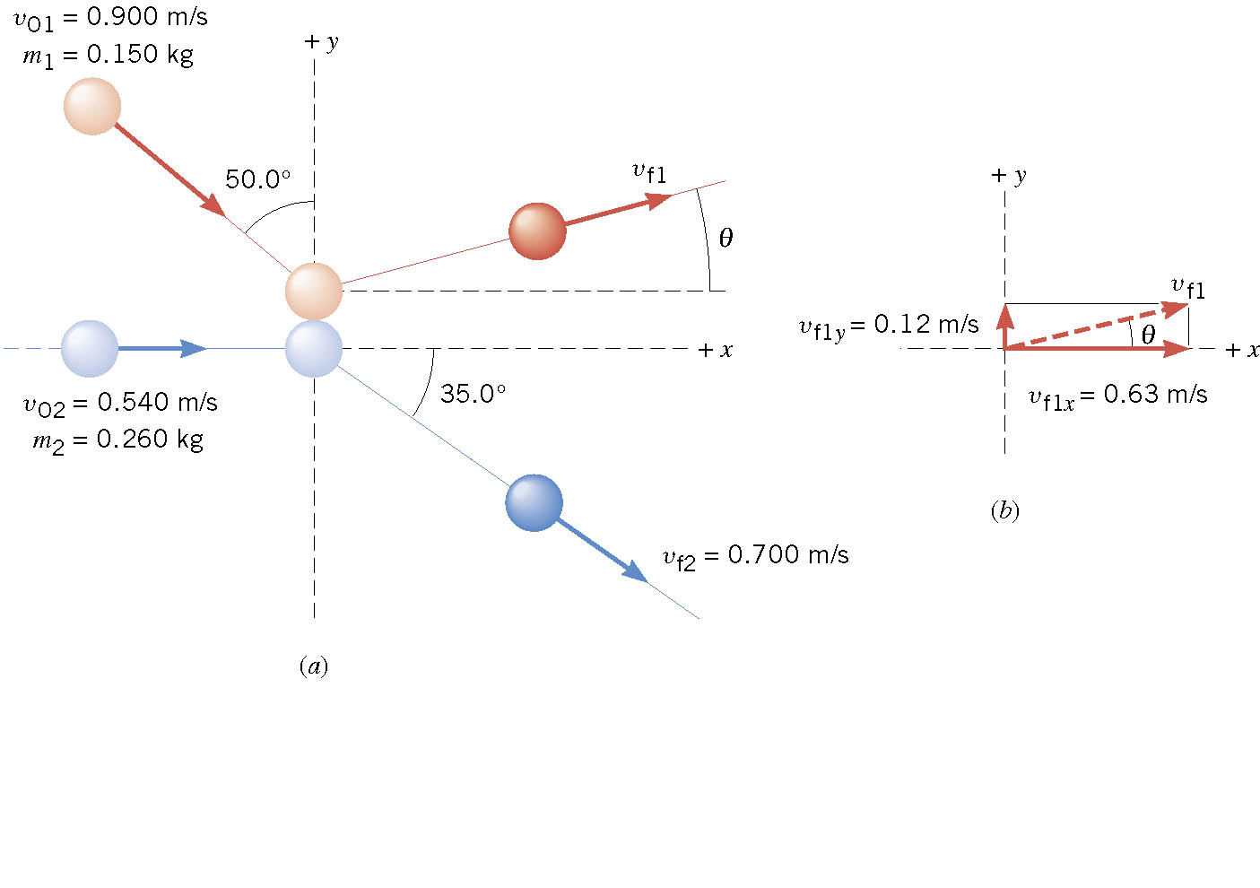
7.4 Collisions in Two Dimensions

Slide 27
7.4 Collisions in Two Dimensions

Slide 28
Key Ideas
Momentum is a vector quantity equal to the mass of an object times its velocity.
Impulse is equal to the force on an object times the amount of time that the force was applied to the object.
The impulse momentum theorem equates impulse to momentum (FΔt = mΔv).
Conservation of momentum requires that the momentum of a system before a collision is equal to the momentum of the system after the collision.

Slide 29
What you already know:
Velocity:
  A vector quantity that is a measure of the change in displacement per unit change in time.
Acceleration:
  A vector quantity that is a measure of the change in velocity per unit change in time.
Mass:
  A scalar quantity that is a measure of the amount of matter an object contains.
Force:
  A vector quantity consisting of a push or pull that may cause an object to change direction or velocity, or both.

